Slide 1
Relational model
and
Relational Algebra
(part-3)

Slide 2
Chapter 3: Relational model and Relational Algebra (T1: Page 225-232)
Relational database Design Using ER-to-Relational Mapping

Slide 3
ER-to-Relational Mapping Algorithm
Step 1: Mapping of Regular Entity Types
Step 2: Mapping of Weak Entity Types
Step 3: Mapping of Binary 1:1 Relation Types
Step 4: Mapping of Binary 1:N Relationship Types.
Step 5: Mapping of Binary M:N Relationship Types.
Step 6: Mapping of Multi-valued attributes.
Step 7: Mapping of N-ary Relationship Types.

Slide 4
Step 1: Mapping of Regular Entity Types
For each regular (strong) entity type (Ei), create a relation that includes all the simple attributes of that Entity.
Includes only the simple component attributes of a composite attribute (if any) (as required).
Choose one of the key attributes of Entity as primary key for Relation.
If the chosen key of Entity is composite, the set of simple attributes together form the primary key of Relation.

Slide 5
Step 1: Mapping of Regular Entity Types
If many key attributes exist, information about all secondary keys are kept for indexing and other types of analyses.

Slide 6
Step 1: Mapping of Regular Entity Types
Example:
Create the relations EMPLOYEE, DEPARTMENT, and PROJECT in the relational schema corresponding to the regular entities in the ER diagram.
SSN, DNUMBER, and PNUMBER are the primary keys for the relations EMPLOYEE, DEPARTMENT, and PROJECT respectively.

Slide 7
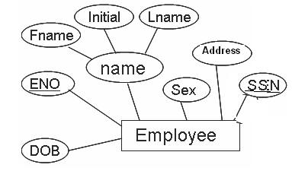
Step 1: Mapping of Regular Entity Types

Slide 8
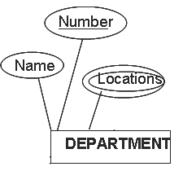

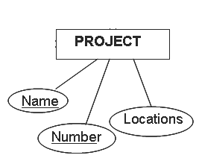

Step 1: Mapping of Regular Entity Types

Slide 9
Step 2: Mapping of Weak Entity Types
For each weak entity type in the ER schema, create a relation.
Include all simple attributes (or simple components of the composite attributes) of Weak entity as attributes of Relation .
Include the primary key attribute (s) of owner entity as foreign key in Weak entity relation.
The primary key for weak entity relation is the combination of the primary key (s) of the owner (s) and the partial key of the weak entity type .

Slide 10
Step 2: Mapping of Weak Entity Types
Example:
Create the relation DEPENDENT in this step to correspond to the weak entity type DEPENDENT.
Include the primary key SSN of the EMPLOYEE relation as a foreign key attribute of DEPENDENT (renamed to ESSN).
The primary key of the DEPENDENT relation is the combination {ESSN, DEPENDENT_NAME} because DEPENDENT_NAME is the partial key of DEPENDENT.

Slide 11
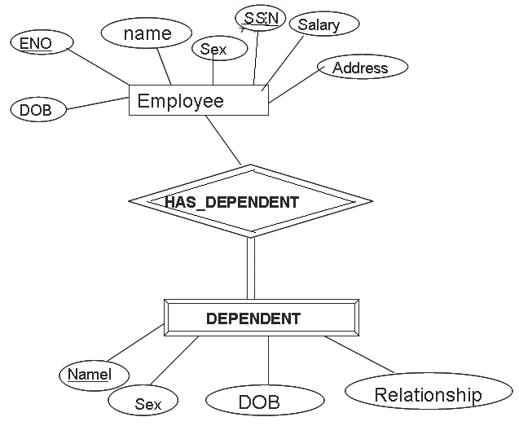
Step 2: Mapping of Weak Entity Types

Slide 12
Step3 : Mapping of Binary 1:1 Relation Types
For each binary 1:1 relation type R in the ER schema, identify the relations S and T that correspond to the entity types participating in the R. There are three possible approaches:
  1) the foreign key approach ,
  2) the emerged relationship approach , and
  3) the cross-reference or relationship relation approach

Slide 13
The foreign key approach
Mostly used
Include Primary key of one relation as foreign key in other relation (generally in the relation which has total participation)
e.g. MGRSSN as foreign key in DEPARTMENT which is primary key in EMPLOYEE due to relation of MANAGES
Because DEPARTMENT entity participation in manages is total.

Slide 14
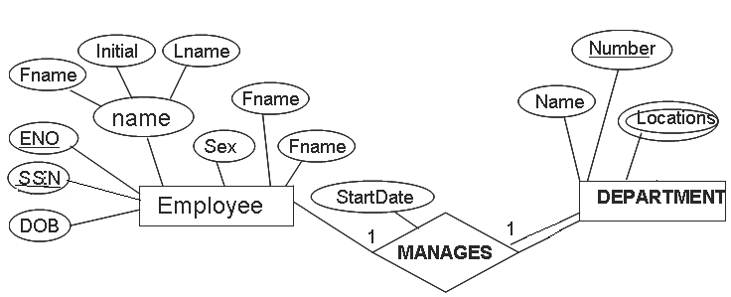
Step3 : Mapping of Binary 1:1 Relation Types

Slide 15
The Merged relationship approach
Merge two entity types and their relationship type in a single relation .
Suitable only when total participation of both the entity exists.
But not widely used

Slide 16
The cross-reference or relationship relation approach
Create a new relation for relationship type.
Include Primary keys of both the relations as foreign key in new relation.
Both primary key together works as composite primary key for new relation.
Used when both entity participation is partial (to avoid more nulls)

Slide 17
Step 4: Mapping of binary 1:N Relationship types
For each regular binary 1:N relationship type R, identify the relation S that represents the participating entity type at the N-side of the relationship type.
Include the primary key of the relation T that represents the other entity type participating in R as foreign key in S

Slide 18
Step 4: Mapping of binary 1:N Relationship types
This is done because each entity instance on the N-side is related to at most one entity instance on the 1-side of the relationship type.
Include any simple attributes (or simple components of the composite attributes) of the 1:N relationship type as attribute of S.

Slide 19
Step 4: Mapping of binary 1:N Relationship types
Example:
1:N relationship types WORKS_FOR, CONTROLS, and SUPERVISION in the figure.
For WORKS_FOR we include the primary key DNUMBER of the DEPARTMENT relation as foreign key in the EMPLOYEE relation and call it DNO.

Slide 20
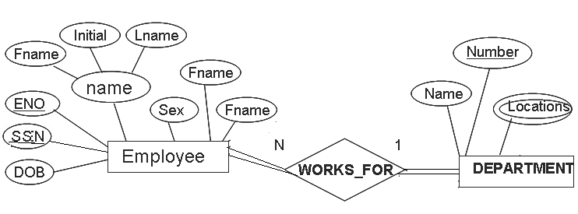
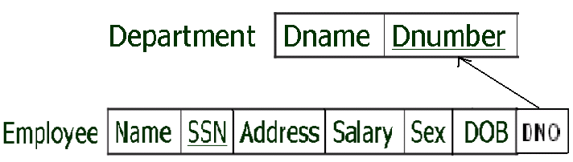
Step 4: Mapping of binary 1:N Relationship types

Slide 21
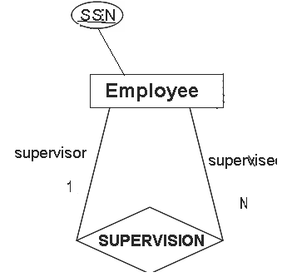

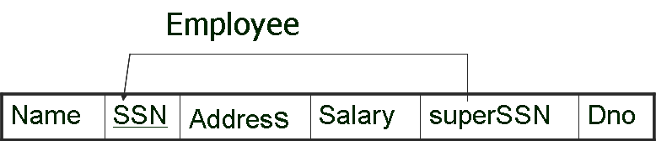
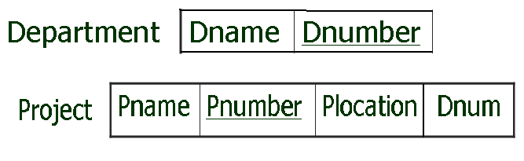
Step 4: Mapping of binary 1:N Relationship types

Slide 22
Step5: Mapping of binary M:N Relationship Types
For each binary M:N relationship type R, create a new relation S to represent R.
Include the primary keys of the relations that represent the participating entity types as foreign key attributes in S
Their combination will form the primary key of S.

Slide 23
Step5: Mapping of binary M:N Relationship Types
Also include any simple attributes of the M:N relationship type (or simple components of composite attributes) as attributes of S.
We cannot represent an M:N relationship type by a single foreign key attribute in one of the participating relations (as we did for 1:1 or 1:N relationship types) because of the M:N cardinality ratio; we must create a separate relation S.

Slide 24
Step5: Mapping of binary M:N Relationship Types
Example:
The M:N relationship type WORKS_ON from the ER diagram is mapped by creating a relation WORKS_ON in the relational database schema.
The primary keys of the PROJECT and EMPLOYEE relations are included as foreign keys in WORKS_ON and renamed PNO and ESSN, respectively.

Slide 25
Step5: Mapping of binary M:N Relationship Types
Example (contd..):
Attribute HOURS in WORKS_ON represents the HOURS attribute of the relation type.
The primary key of the WORKS_ON relation is the combination of the foreign key attributes {ESSN, PNO}.

Slide 26
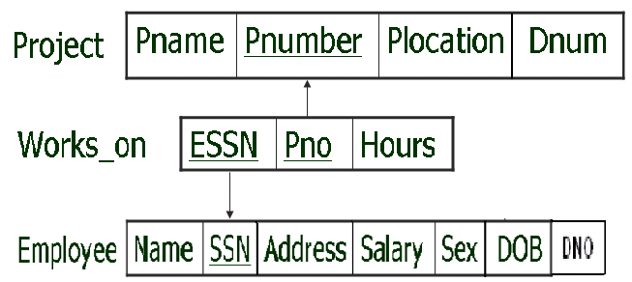
Step5: Mapping of binary M:N Relationship Types
EMPLOYEE
WORKS_ON
PROJECT

Slide 27
Step 6: Mapping of the Multivalued Attributes
For each multivalued attribute A, create a new relation R .
This relation R will include an attribute corresponding to A, plus the primary key attribute K of main relation as a foreign key in new relation
The primary key of R is the combination of A and K .
If the multivalued attribute is composite, we include its simple components

Slide 28

Step 6: Mapping of the Multivalued Attributes
Example:
The relation DEPT_LOCATIONS is created. The attribute DLOCATION represents the multivalued attribute LOCATIONS of DEPARTMENT, while DNUMBER-as foreign key-represents the primary key of the DEPARTMENT relation. The primary key of R is the combination of {DNUMBER, DLOCATION}.

Slide 29
Step 7: Mapping of N-ary relationship Types
For each n-ary relationship type , where n>2 , create a new relation S to represent Relationship type.
Include the primary keys of the relations that represent the participating entity types as foreign key attributes in S .

Slide 30
Step 7: Mapping of N-ary relationship Types
Also include any simple attributes of the n-ary relationship type (or simple components of composite attributes) as attributes for S .
The primary key of S is usually a combination of all the foreign keys that references the relations representing the participating entity types .

Slide 31
Step 7: Mapping of N-ary relationship Types
Example:
The relationship type SUPPY in the ER below. This can be mapped to the relation SUPPLY shown in the relational schema, whose primary key is the combination of the three foreign keys {SNAME, PARTNO, PROJNAME}

Slide 32
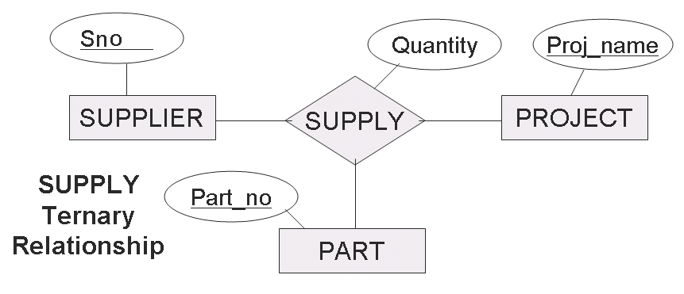
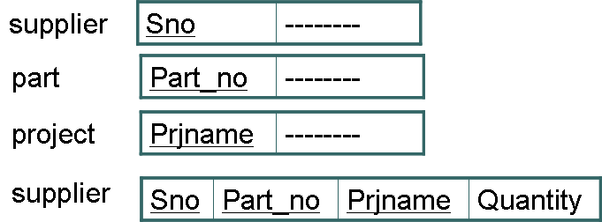
Step 7: Mapping of N-ary relationship Types

Slide 33
End of chapter 3
(part-3)

